Slide 1
Real-Time Conducting Animation from Sheet Music
Kseniya Rychkova
CSC 498
Mentor: Dr. Salgian

Slide 2
Motivation
Help student musicians practice their music without a conductor by providing a simple visual for a piece of music
Display a colorful visual to add excitement to an orchestra performance
Orchestral performances provide auditory entertainment to the audience, but not much visual

Slide 3




Conducting
Time signature - affects the pattern of the conductor’s hand motions
Beats per measure / value of one beat
2/4, 3/4, 4/4, 6/8 are some common time signatures
Tempo - how fast-paced the music is
How many beats per minute? How quickly should the conductor be directing the music?
Dynamics - the loudness or softness of the music at any point
Piano, Forte, Crescendo, Decrescendo, etc. represent changes in dynamics
Rest measures - sometimes instruments take breaks in the music
Musicians need to know when they should prepare to begin playing again after rest measures

Slide 4
MusicXML
XML stands for eXtensible Markup Language
Designed to store and transport data
Basically formatted <tag>value</tag>
MusicXML (.musicxml) is a specific kind of XML format designed for a digital representation of sheet music
It’s a fairly new format, and many music notation applications are beginning to include it as a supported format
MuseScore, Finale, ScoreCloud

Slide 5
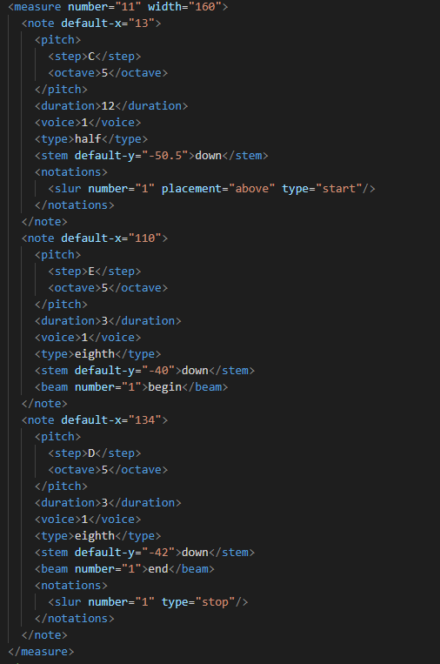
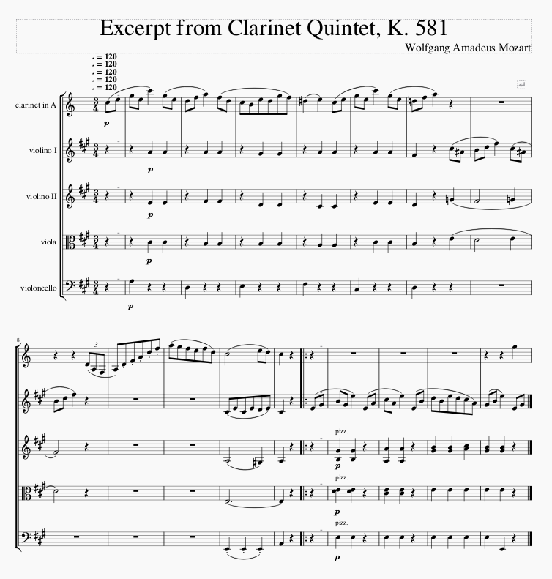

Slide 6
Conducting Project
User is able to select a .musicxml file, as well as its respective and .mid file (in order to play the music alongside the animation, for demo purposes)
Program quickly parses the .musicxml file, and opens a window that will play an animation as well as the music (provided by the .mid file).
The window is initially paused; the user can click anywhere on the window to begin playing, and clicking again will pause both the animation and the music.

Slide 7
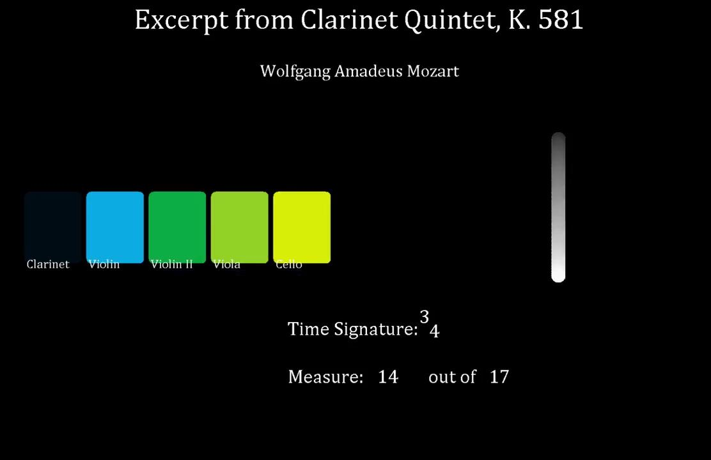

Slide 8

Conducting Project - Piece Info
Top of the window displays piece information
Piece title (or “Unknown Title” if there is the piece does not have a title)
Authors/contributors

Slide 9
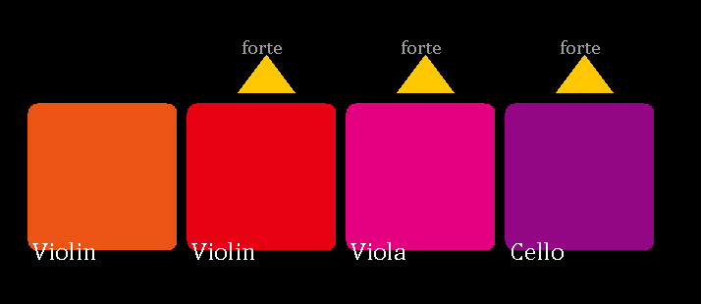
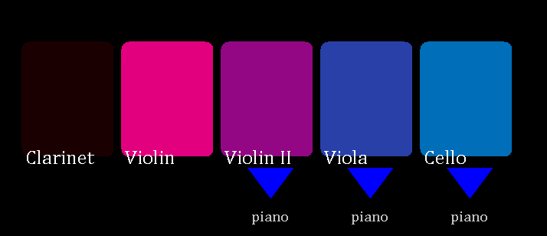
Conducting Project - Orchestra
The left side displays a line of colored blocks, each representing an instrument part from the music piece
Colors are semi-randomized each time the program is run
Blocks fade out when the music part has rest measures, and fade back in when the music part enters the orchestra again
Yellow up-arrows appear above the instrument part when the dynamics increase, and blue down-arrows appear below the part when they decrease

Slide 10
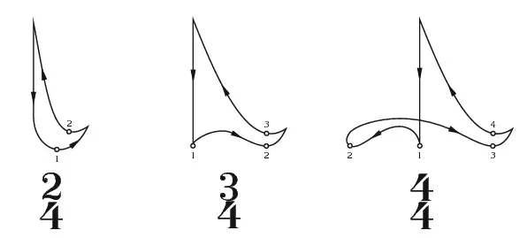
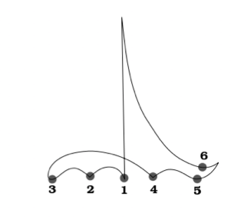

Conducting Project - Right Hand
The Right Hand is the circle moving in a pattern in time with the music on the right side of the window
Different pattern based off the time signature
Speed of the motion is based off the tempo of the piece
The patterns that I have implemented are:
2 beats per measure
3 beats per measure
4 beats per measure
6 beats per measure

Slide 12
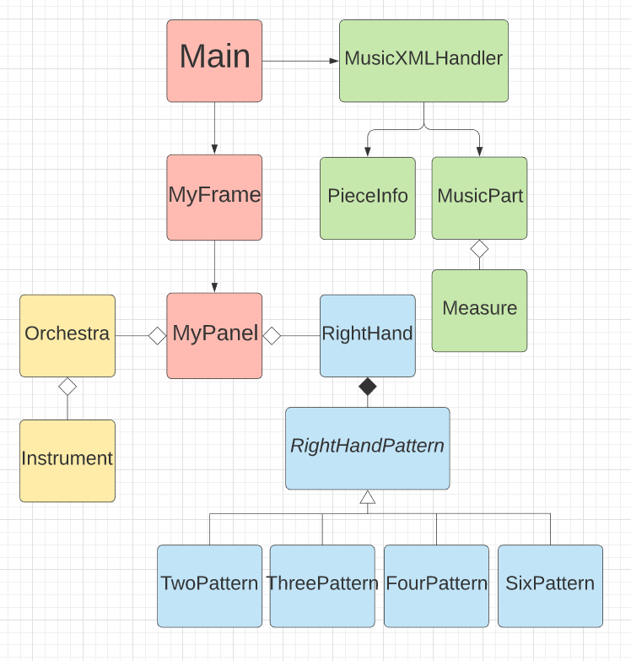

Slide 13
Results and Future Work
Tested the program on a variety of files with different attributes to make sure all parts work correctly
Future work:
Ability to rewind the animation
Give user ability to adjust their preferences for the animation
Sheet music can be interpreted differently by different musicians
Incorporate more factors from the .musicxml file

Slide 14
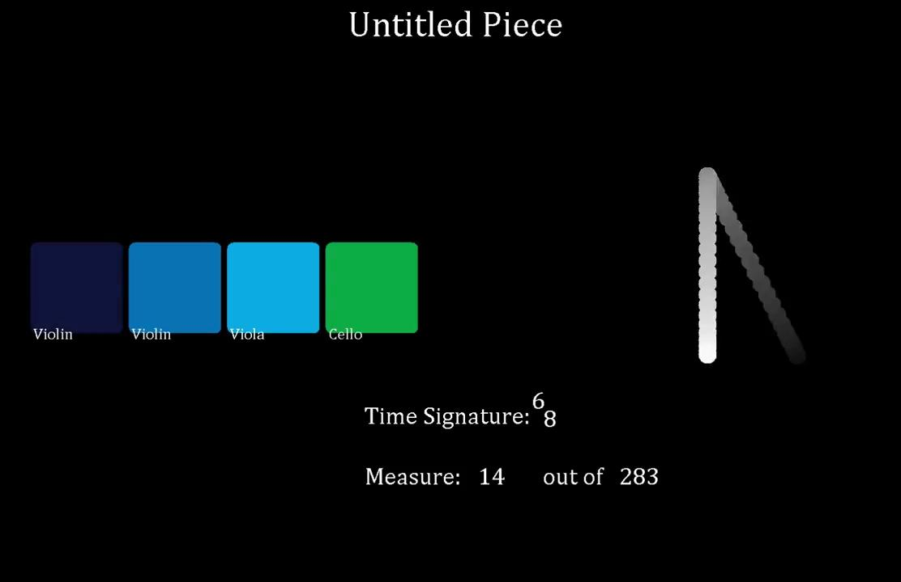

Slide 15
